Slide 1
Dynamic Operating Envelopes
Athul Jose P
11867566

Slide 2
Introduction
Intermittent and uncertain supply from DERs
Potential of DERs in participating markets
Load aggregator bundles large number of DERs to participate in wholesale energy market
Need of scheduling energy and calculating optimal flexibility – Optimal Flexibility Design (OFD)
Geometric Techniques - polytope
Multilevel Optimization Problem - ellipsoid

Slide 3
Dynamic Operating Envelope
Operating envelopes are the limits that an electricity customer can import and export to the electricity grid
Dynamic Operating Envelopes(DOEs) are where import and export limits can vary over time and location.
DOE enables higher levels of energy exports from customers’ solar and battery systems by allowing higher export limits when there is more hosting capacity on the local network

Slide 4
Dynamic Operating Envelope
Aggregators comprises of large no of active consumers participating in energy market and ancillary service market
Aggregated response at system level
Operating Envelope: Time varying export or import levels
Roles
Distribution System Operator
Distribution Market Operator
The aggregator

Slide 5
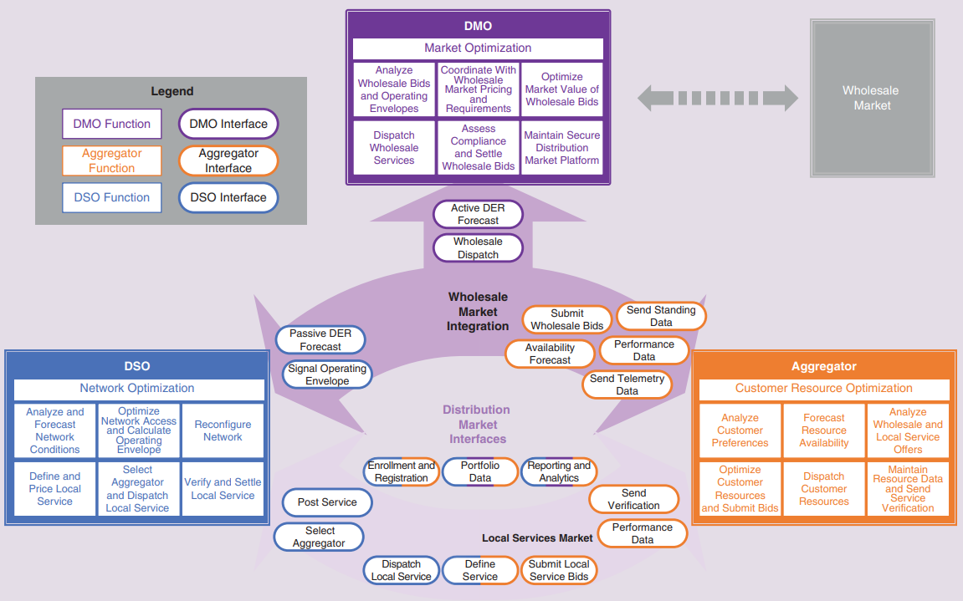

Slide 6
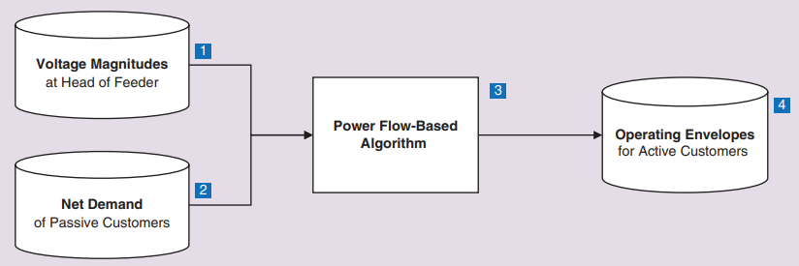
Calculating Operating Envelope

